Slide 1

Set, Dictionary, Membership
A mother identifies her twin off-springs uniquely; not-so-naïve?
Prathmesh Palande
Pratik Loya
TOC EUS Automation
May 14, 2019

Slide 2
Section 1
Set, Dictionary, Membership

Slide 3

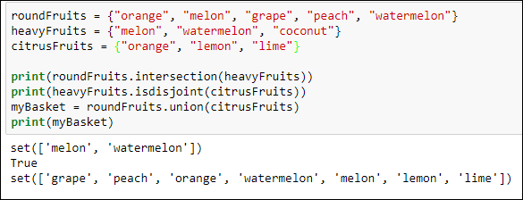
Sets
Set – unordered collection of items with no duplicate elements
Sample Methods:
add
remove
copy
clear
difference
difference_update
pop
update
discard
intersection
intersection_update
isdisjoint
issubset
issuperset
symmetric_difference
symmetric_difference_update
union
Create set:

Slide 4
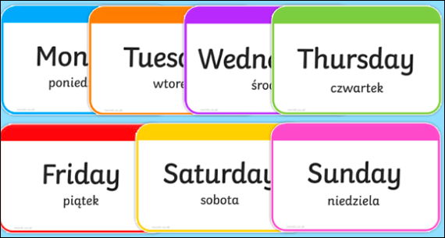



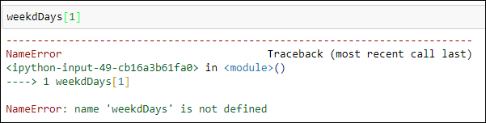
Dictionaries
- Dictionary – unordered and mutable collection of items
Create dictionary:
Accessing Items
The wrong way

Slide 5

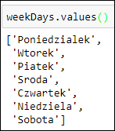
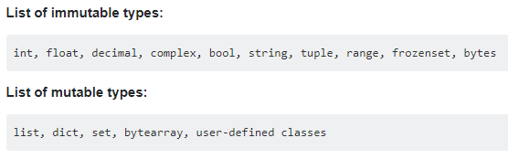
Dictionaries, in-a-nut-shell
Creating a new dictionary
newDict = {key : value}
Keys and values
Any hashable type can be used as a dictionary key
Immutable: Hashable
Mutable: Not Hashable

Slide 6
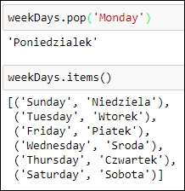
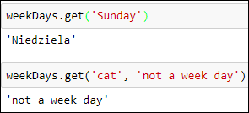
Playing around with Dictionaries
Methods:
keys
values
items
get
copy
fromkeys
popitem
setdefault
pop
Update
clear

Slide 7
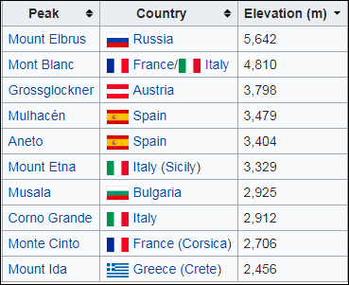


Tuples
- ordered and immutable (unchangeable) collection of items
- allows duplicate members
- to add or remove items, you must redeclare
-Example uses of tuples
Country Names
Mountain Peaks
Ordered set of functions
var = (‘one’, 2, ‘three’, ‘banana’)
Accessing elements

Slide 8


Tuples Operations
Methods*:
count() : returns the number of times a specified value appears in the tuple.
index():
- finds the first occurrence of the specified value
- raises an exception if the value is not found.
*Operations which cause potential changes to a tuple are not permissible; reinforce the idea of immutability

